Slide 1



Banks_StockAnalysis_Capstone
View in Power BI
Last data refresh:
4/21/2021 6:49:22 PM UTC
Downloaded at:
4/21/2021 6:53:13 PM UTC

Slide 2
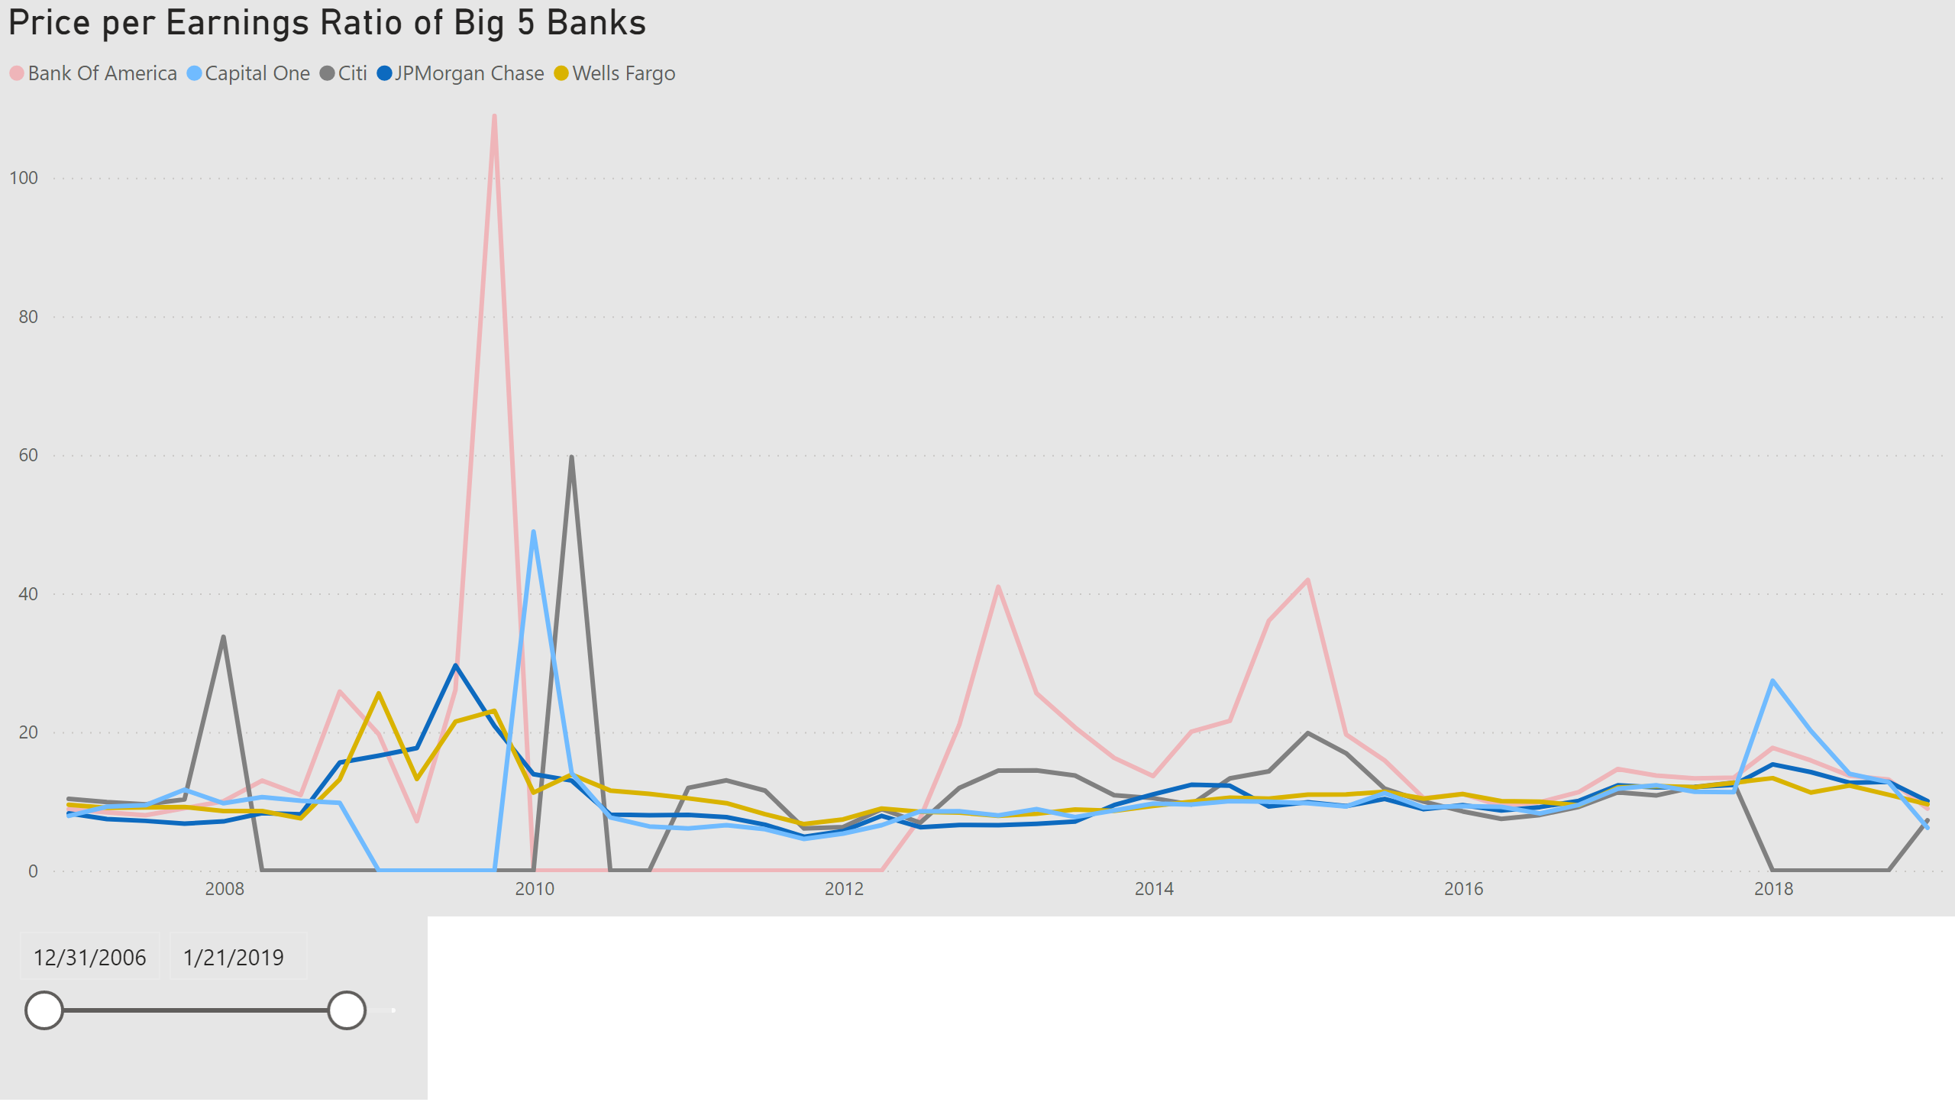
P/E Ratio All
Notes:
Price per Earnings Ratio of Big 5 Banks
No alt text provided.
slicer
No alt text provided.

Slide 3
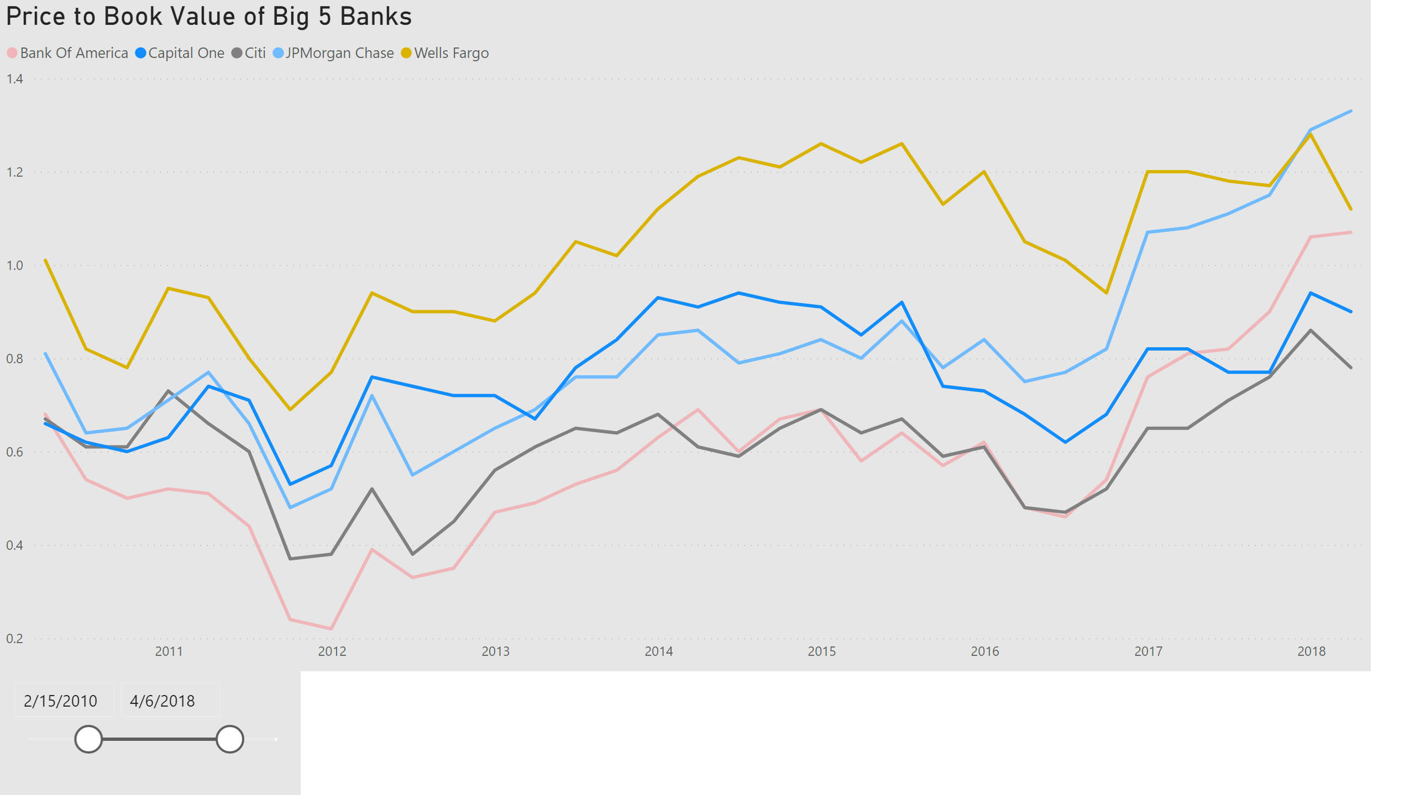
P/B Ratio All
Notes:
Price to Book Value of Big 5 Banks
No alt text provided.
slicer
No alt text provided.

Slide 4
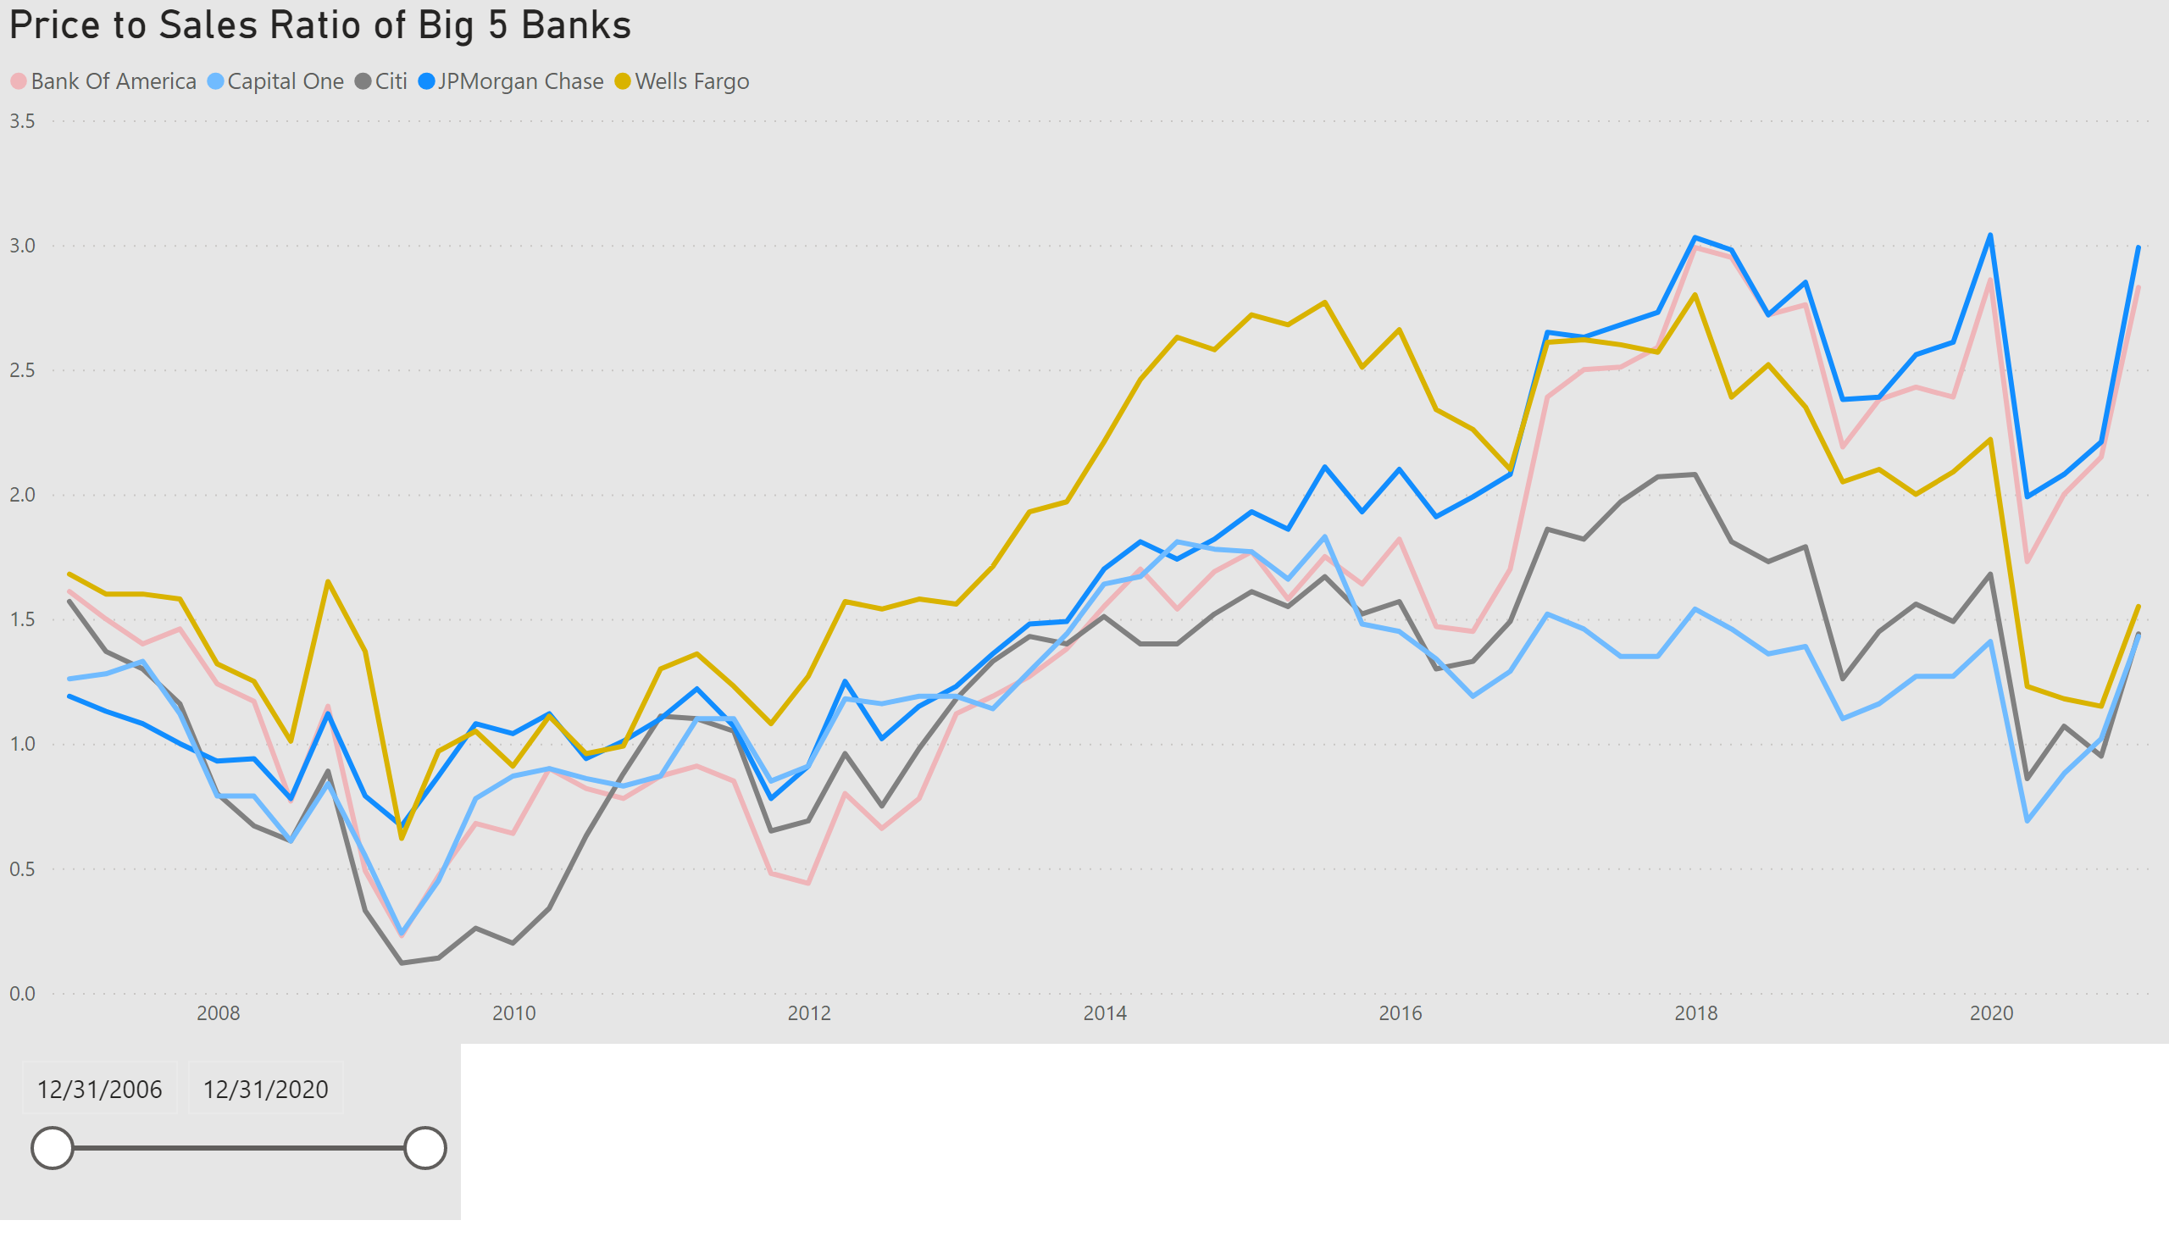
P/S Ratio All
Notes:
Price to Sales Ratio of Big 5 Banks
No alt text provided.
slicer
No alt text provided.

Slide 5
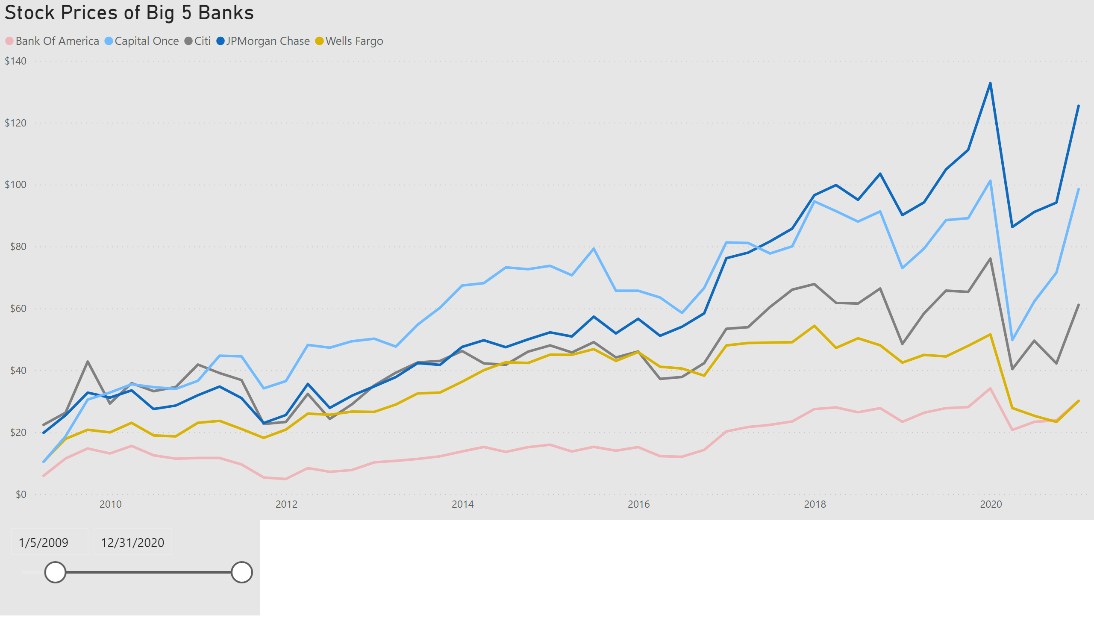
Stock Price All
Notes:
Stock Prices of Big 5 Banks
No alt text provided.
slicer
No alt text provided.

Slide 6
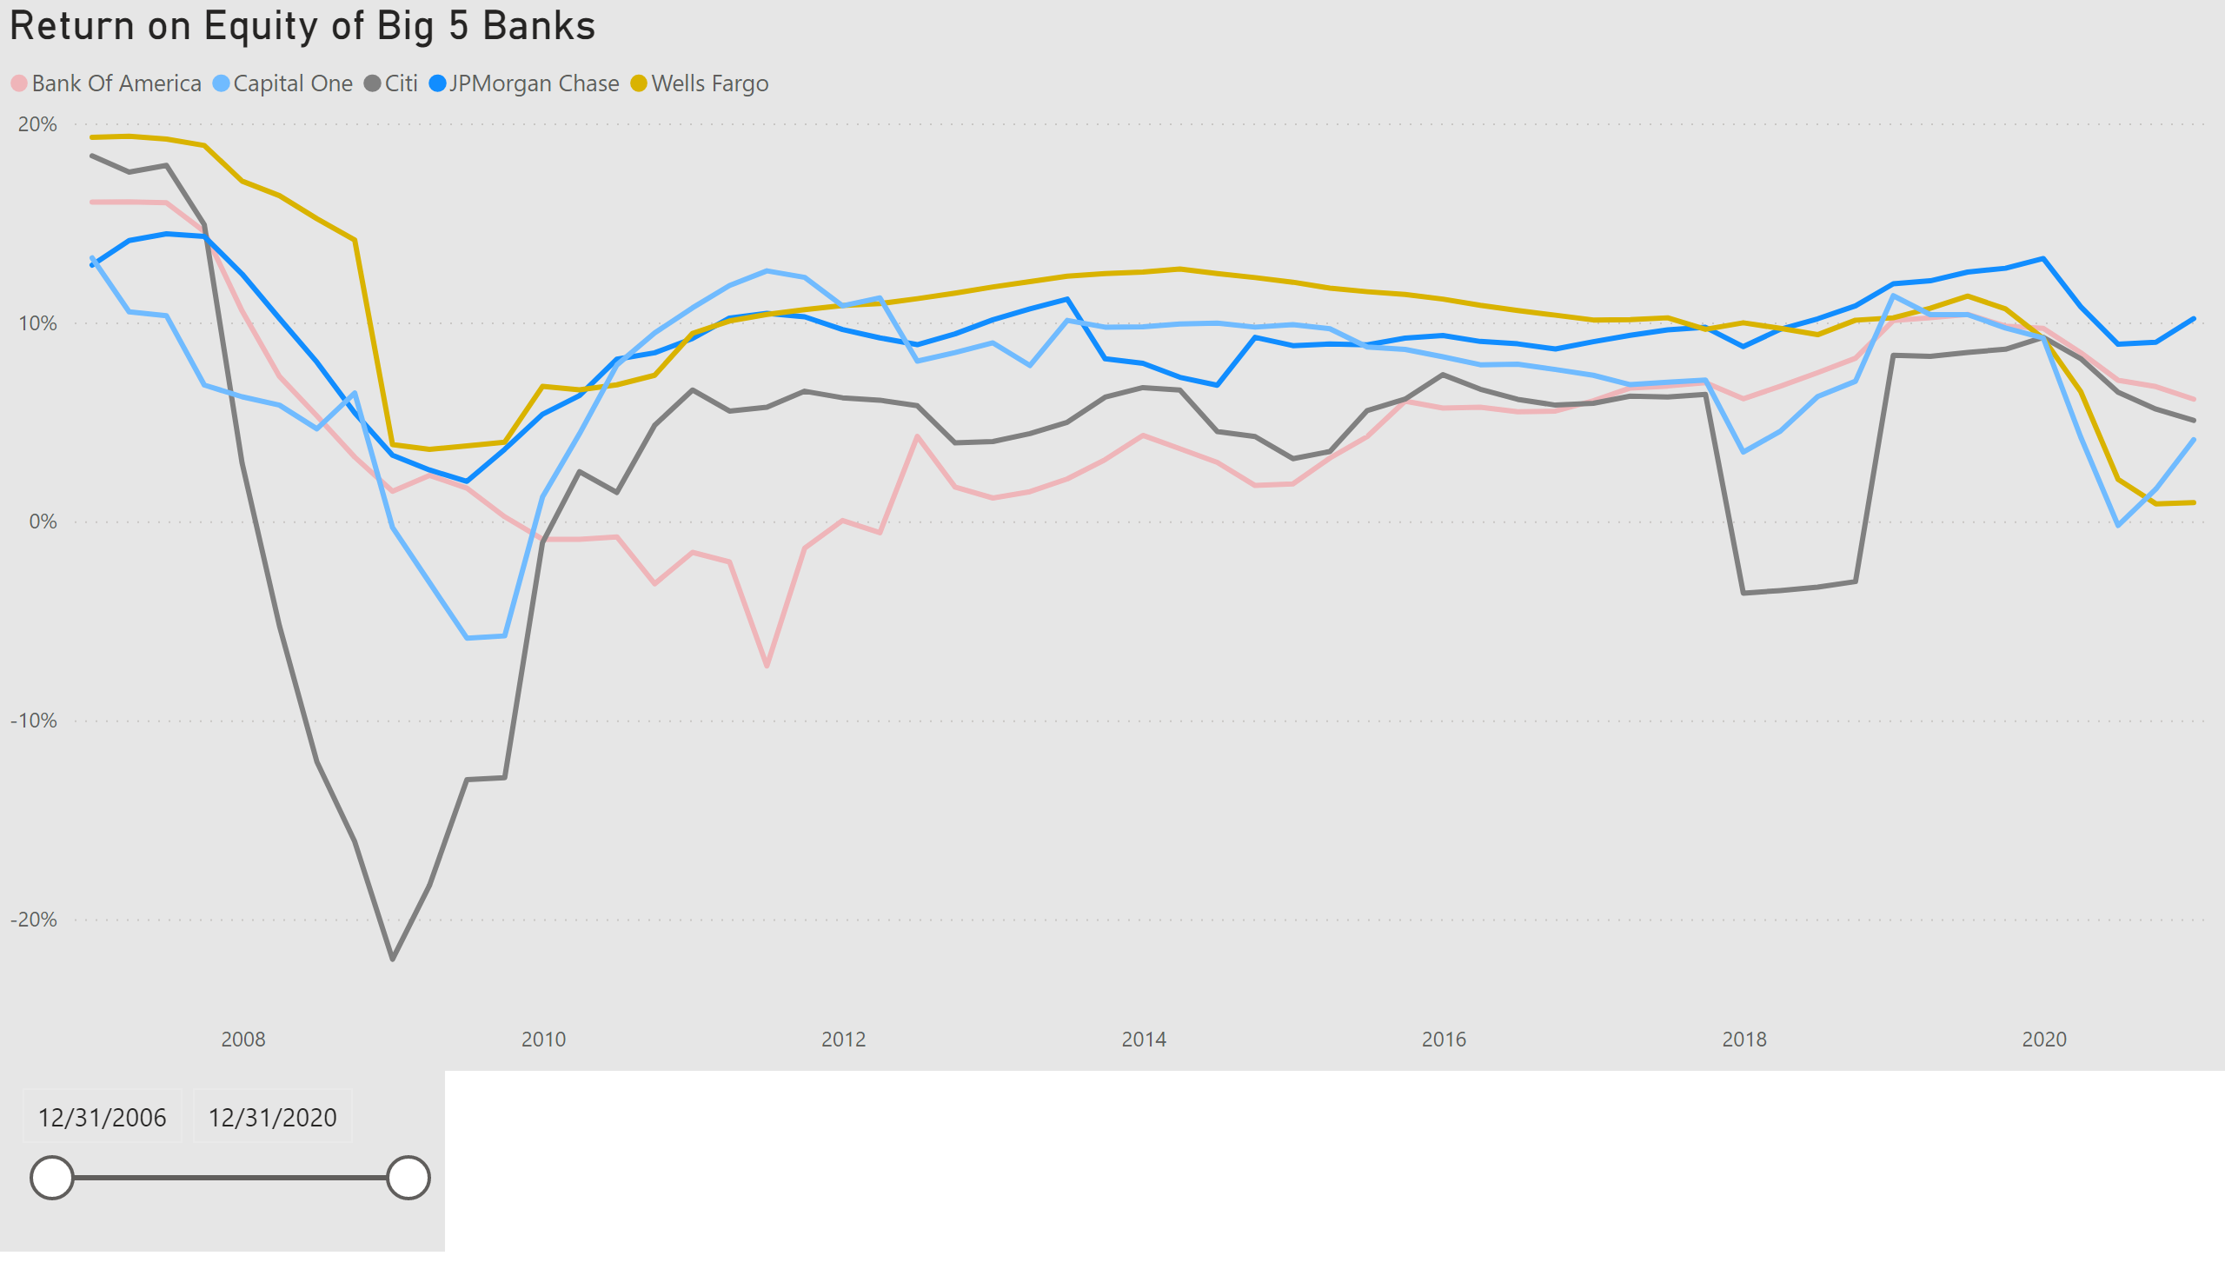
ROE All
Notes:
Return on Equity of Big 5 Banks
No alt text provided.
slicer
No alt text provided.

Slide 7
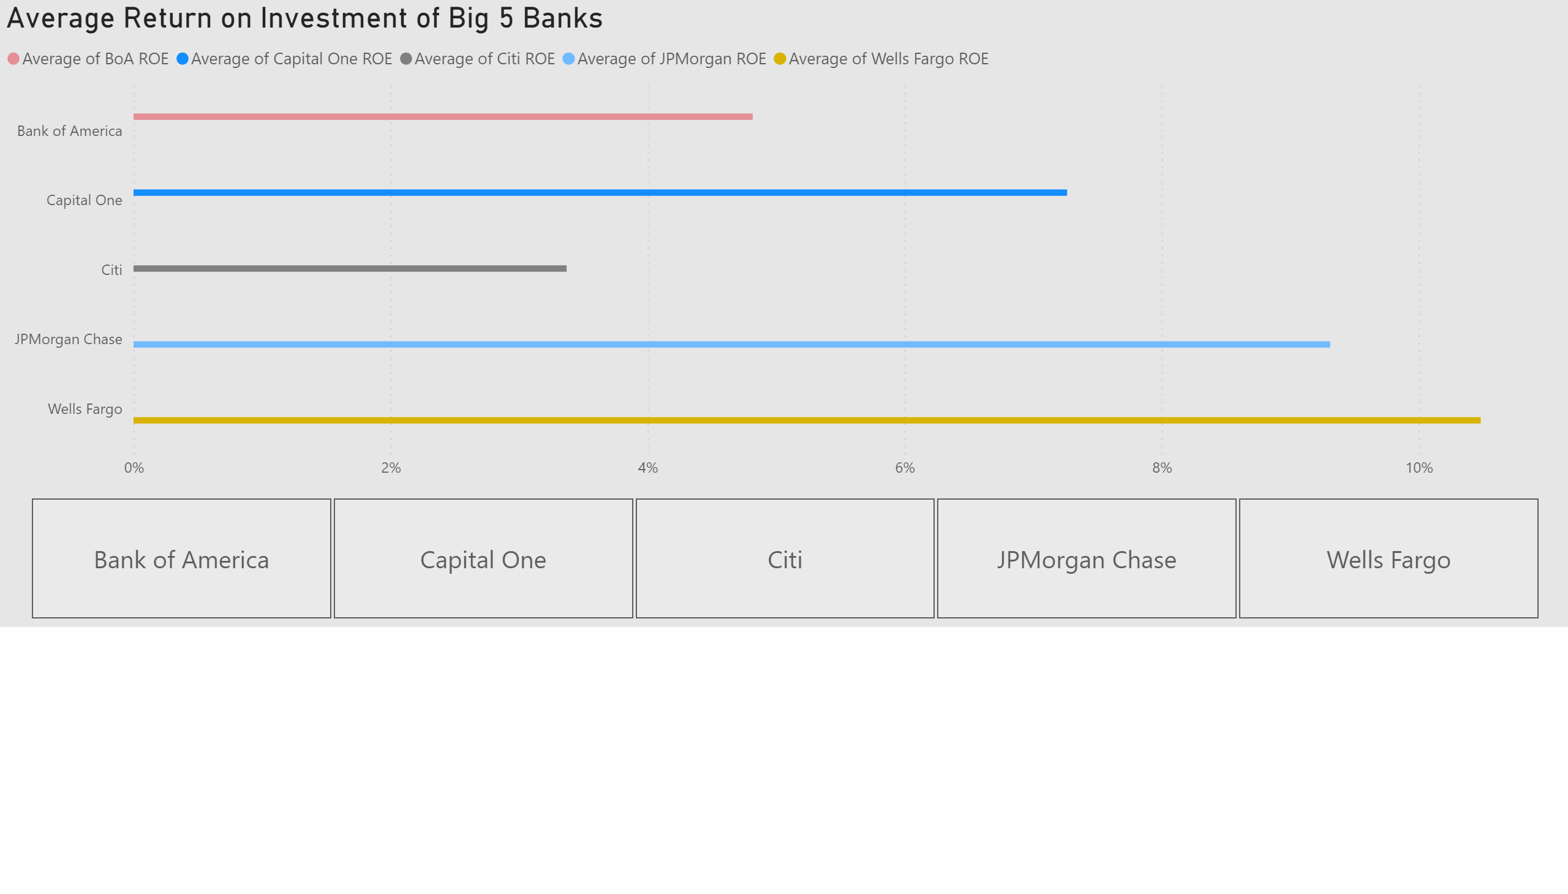
Avg ROE All
Notes:
Average Return on Investment of Big 5 Banks
No alt text provided.
slicer
No alt text provided.

Slide 8
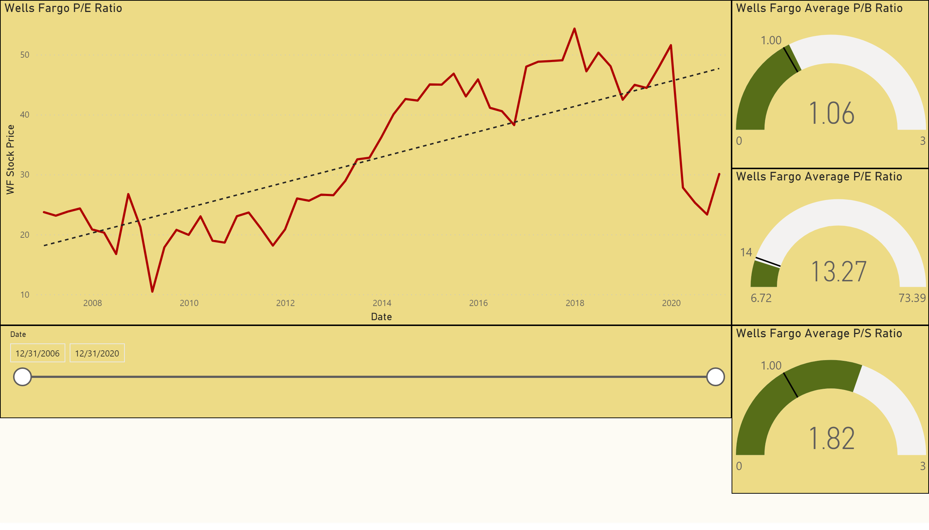
Stock Price Analysis Clean
Notes:
Wells Fargo P/E Ratio
No alt text provided.
Wells Fargo Average P/B Ratio
No alt text provided.
Wells Fargo Average P/E Ratio
No alt text provided.
slicer
No alt text provided.
Wells Fargo Average P/S Ratio
No alt text provided.

Slide 9
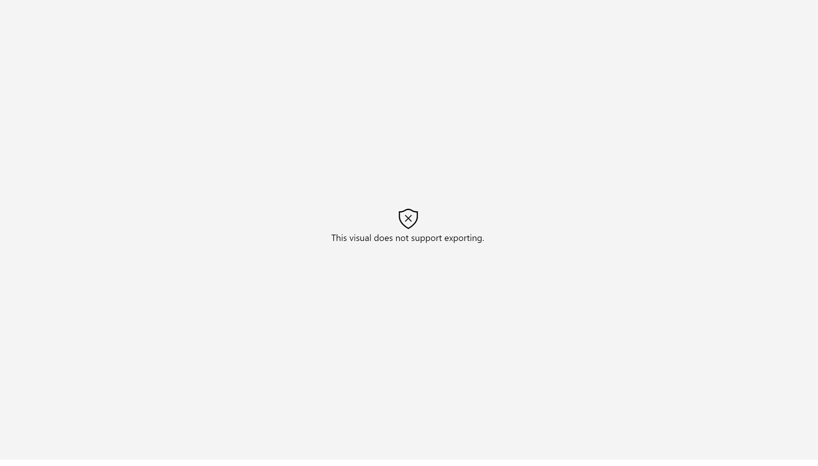
Forecasts for WF Stock Price
Notes:
forecastTools93EB212B02C44467B120F2563F68A7F6
No alt text provided.

Slide 10
WF ROE Forecast
Notes:
forecastTools93EB212B02C44467B120F2563F68A7F6
No alt text provided.

